Slide 1
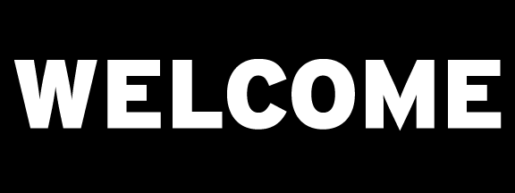

Introduction to Machine Learning
DBDA.X408.(33)
Instructor:
Bill Chen
UCSC Silicon Valley Extension
E: xchen375@ucsc.edu

Slide 2
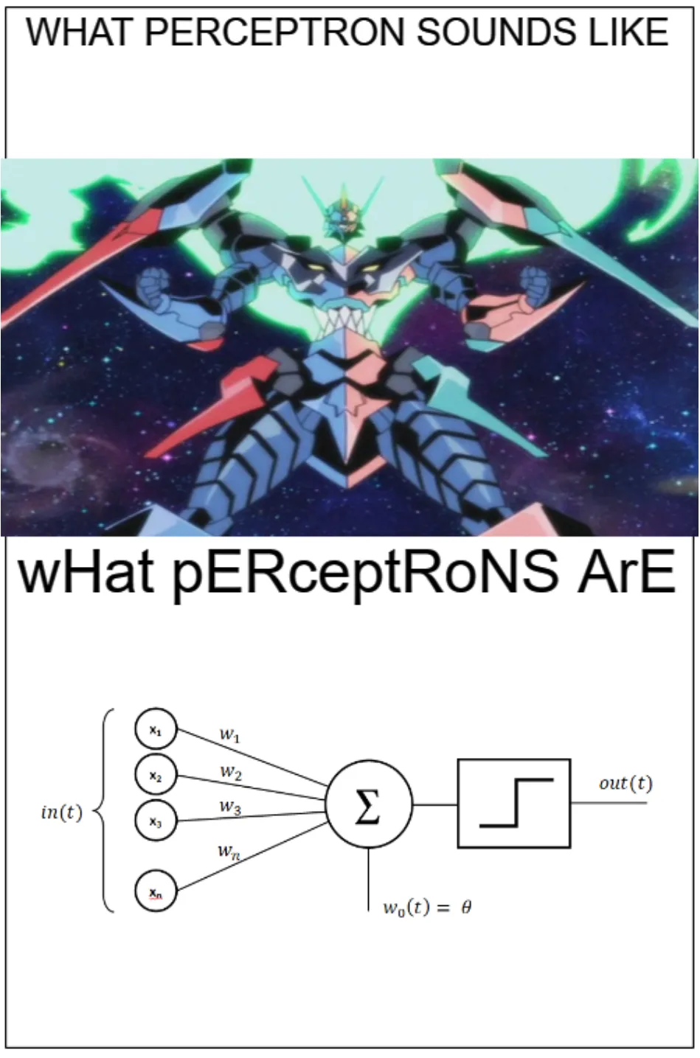
Week 6
Random Forest.
Extremely Randomized Trees.
Gradient Boosted Regression Trees.
SVM revisiting.
Perceptron.
Neural Network.

Slide 3
Random Forest

Slide 4
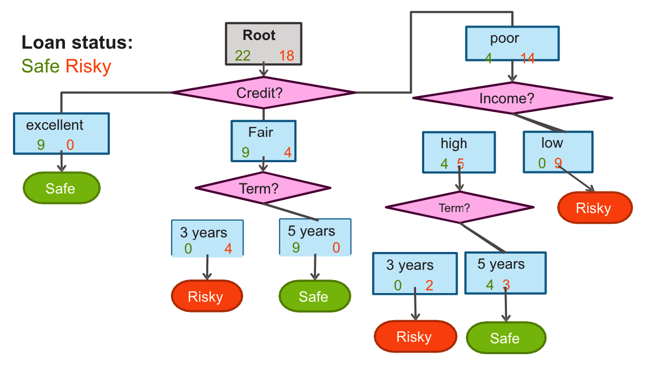
Decision trees (Breiman et al., 1984)
Algorithm:
Step-1: Begin the tree with the root node, says S, which contains the complete dataset.
Step-2: Find the best attribute in the dataset using Attribute Selection Measure (ASM).
Step-3: Divide the S into subsets that contains possible values for the best attributes.
Step-4: Generate the decision tree node, which contains the best attribute.
Step-5: Recursively make new decision trees using the subsets of the dataset created in step -3. Continue this process until a stage is reached where you cannot further classify the nodes and called the final node as a leaf node.

Slide 5
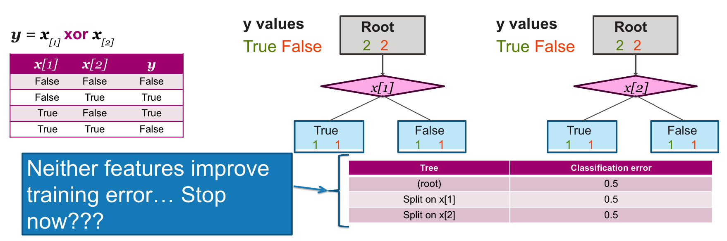
Decision Tree Pruning
Pre-pruning or early stopping
This means stopping before the full tree is even created. We can keep making the tree until the next node doesn’t change the error rate change drastically. Whenever we see a very minor change in the error rate after building the next node, we can stop building further.
Post Pruning
Creating the full tree up until we have very few data points in each set and then track backing such that the change in the error rate is not much.
Do you remember last time we try NOT to stop split when the classification error didn’t decrease?
https://colab.research.google.com/drive/1rB1xsYvWZ4Z-peFHJE1zahK9LTCSvwx9#scrollTo=2PLA2uuGlyGx&line=1&uniqifier=1

Slide 6
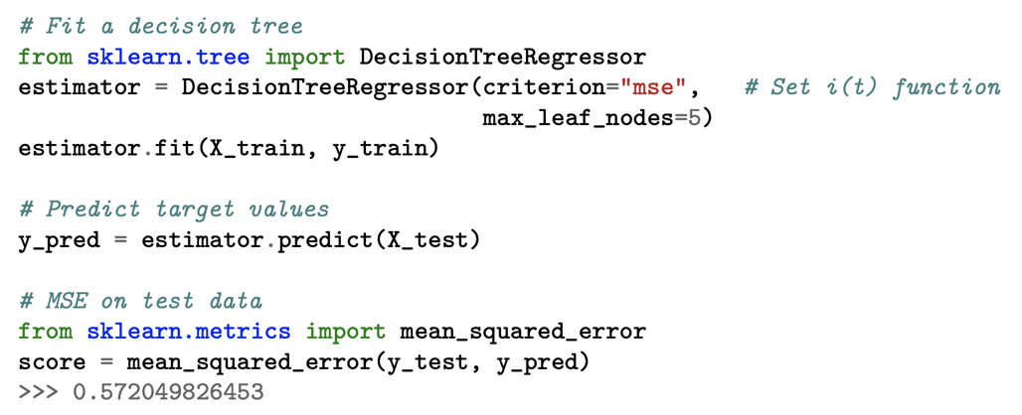
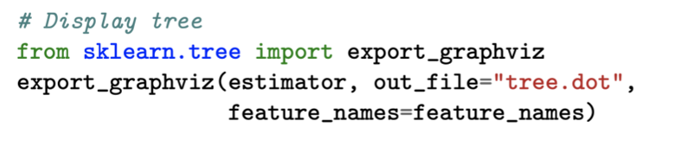
sklearn.tree

Slide 7
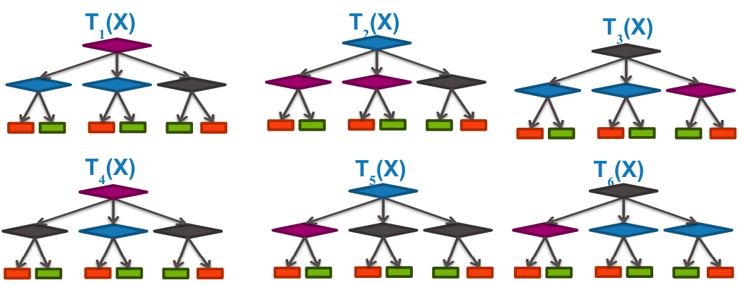
Intuition of Random Forest
You can have many decision trees.
But how can we have many different trees?

Slide 8
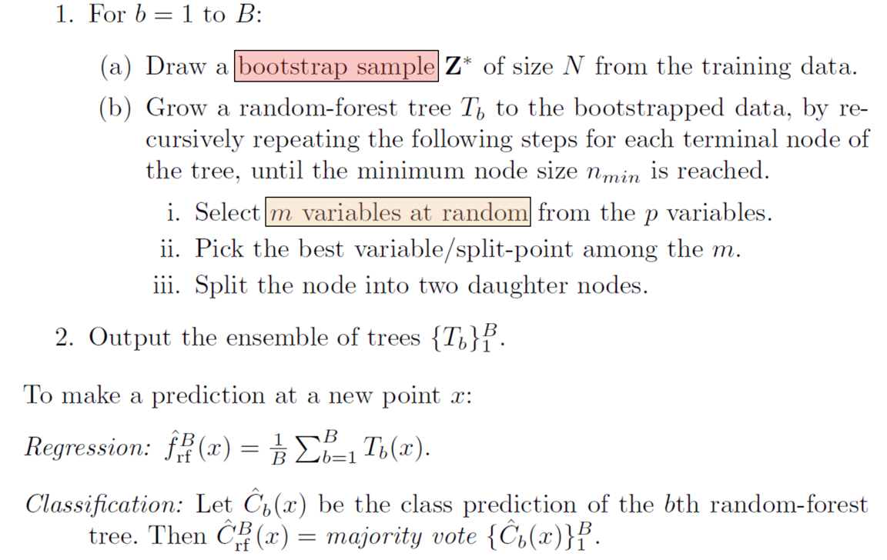
Random Forests (Breiman, 2001; Geurts et al., 2006)
Differences to standard tree:
Train each tree on bootstrap resample of data (Bootstrap resample of data set with N samples:
Make new data set by drawing with replacement N samples; i.e., some samples will probably occur multiple times in new data set)
For each split, consider only m randomly selected variables
Don’t prune
Fit B trees in such a way and use average or majority voting to aggregate results
Notes:
B trees: balanced tree,

Slide 9
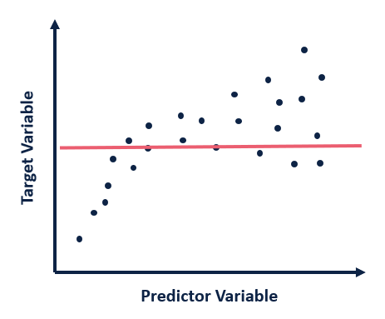
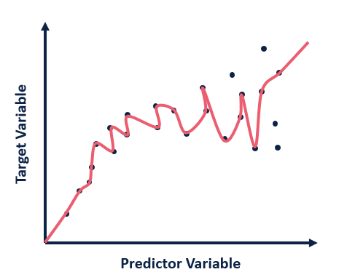
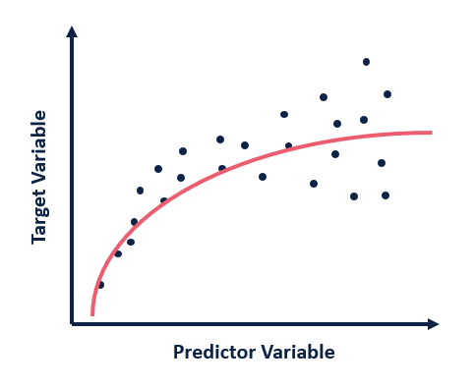
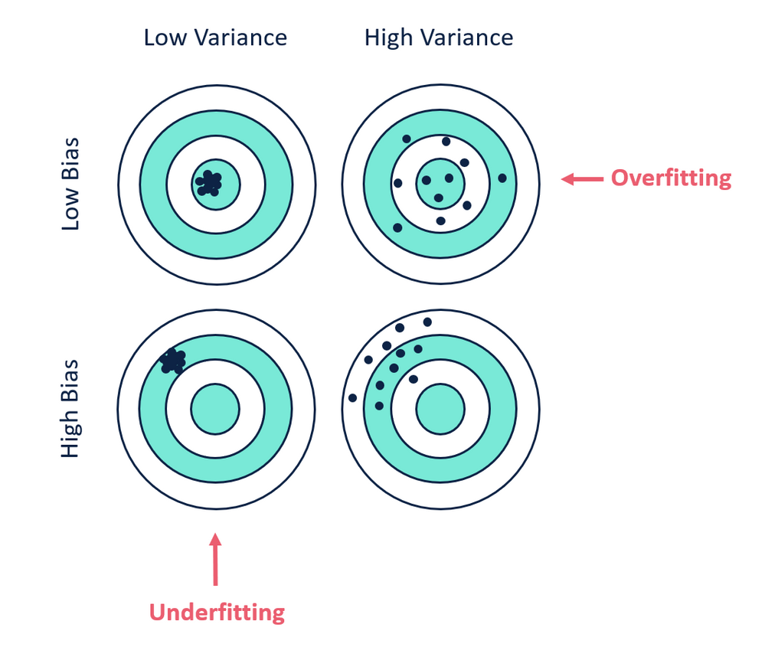
Tree vs. Random Forest
Tree
Trees yield insight into decision rules.
Rather fast.
Easy to tune parameters.
Prediction of trees tend to have a high variance.
Random Forest
RF as smaller prediction variance and therefore usually a better general performance.
Easy to tune parameters.
Rather slow.
“Black box”: rather hard to get insights into decision rules.

Slide 10
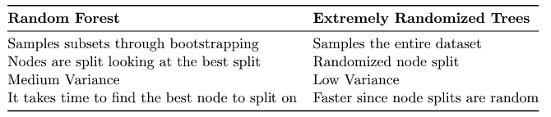
Extremely Randomized Trees
Extremely Randomized Trees, also known as Extra Trees, construct multiple trees like RF algorithms during training time over the entire dataset. During training, the ET will construct trees over every observation in the dataset but with different subsets of features.
It is important to note that although bootstrapping is not implemented in ET’s original structure, we can add it in some implementations. Furthermore, when constructing each decision tree, the ET algorithm splits nodes randomly.
https://colab.research.google.com/drive/1rB1xsYvWZ4Z-peFHJE1zahK9LTCSvwx9#scrollTo=jnOG-i0XqQyG&line=1&uniqifier=1

Slide 11
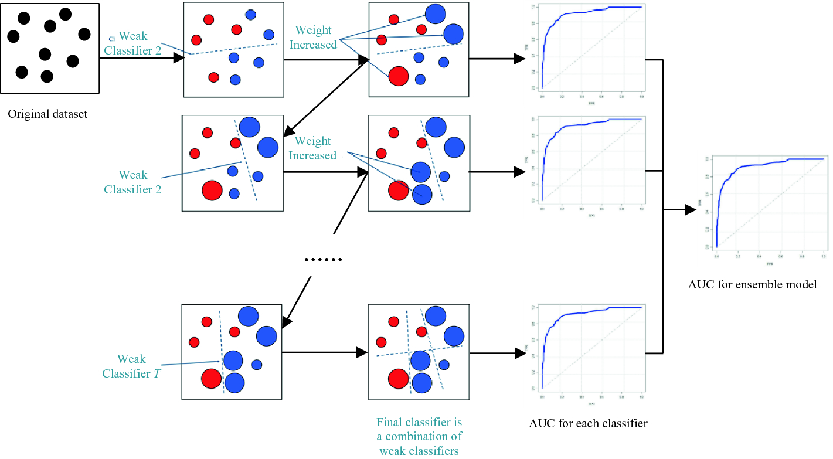
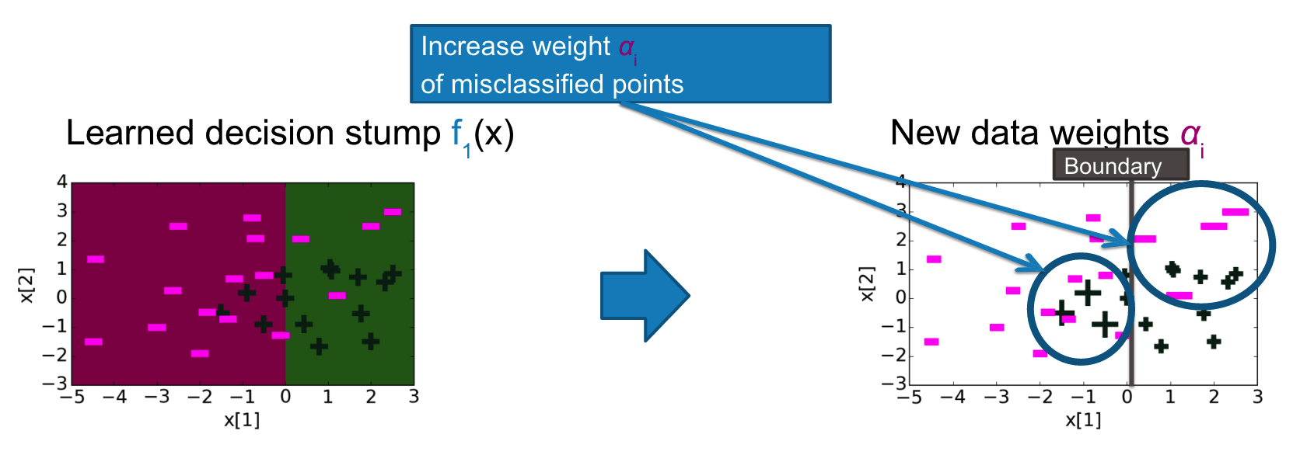
Gradient Boosted Regression Trees (Friedman, 2001)
From Week 5 Boosting

Slide 12
Strengths and Weaknesses of GBRT
Often more accurate than random forests.
Flexible framework, that can adapt to arbitrary loss functions.
Fine control of under/overfitting through regularization (e.g., learning rate, subsampling, tree structure, penalization term in the loss function, etc).
Careful tuning required.
Slow to train, fast to predict.
https://colab.research.google.com/drive/1rB1xsYvWZ4Z-peFHJE1zahK9LTCSvwx9#scrollTo=45SEV3Js1PTf&line=1&uniqifier=1

Slide 13
Variable Importances

Slide 14
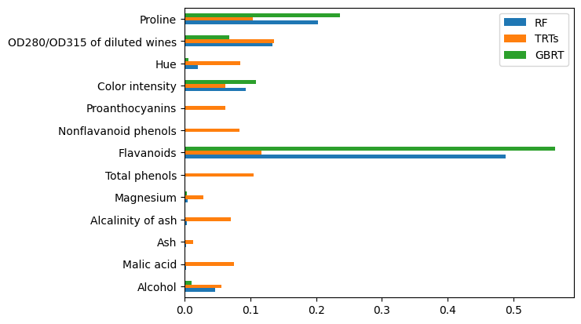
Feature (Variable) Selection/Ranking/Exploration
Tree-based models come with built-in methods for variable selection, ranking or exploration.
The main goals are:
To reduce training times;
To enhance generalisation by reducing overfitting;
To uncover relations between variables and ease model interpretation.
https://colab.research.google.com/drive/1rB1xsYvWZ4Z-peFHJE1zahK9LTCSvwx9#scrollTo=vScYMt173lf5

Slide 15
SVM Revisiting

Slide 16


Motive: Linear Classification
(𝑤∗)^{𝑇}𝑥 = 0
(𝑤∗)^{𝑇}𝑥 > 0
_{𝑤}∗
(𝑤∗)^{𝑇}𝑥 < 0
Class +1
Class -1
Assume perfect separation between the two classes

Slide 17
Motive: Multiple Optimal Solutions?
(𝑤∗)^{𝑇}𝑥 > 0
(𝑤∗)^{𝑇}𝑥 < 0
Class +1
𝑤₁ 𝑤₂ 𝑤₃
Class -1
Same on empirical loss; Different on test/expected loss

Slide 18
What about 𝑤₁?
New test data
(𝑤∗)^{𝑇}𝑥 > 0
(𝑤∗)^{𝑇}𝑥 < 0
Class +1
𝑤₁
Class -1
Same on empirical loss; Different on test/expected loss

Slide 19
What about 𝑤₃?
New test data
(𝑤∗)^{𝑇}𝑥 > 0
(𝑤∗)^{𝑇}𝑥 < 0
Class +1
𝑤₃
Class -1
Same on empirical loss; Different on test/expected loss

Slide 20
Most confident: 𝑤₂
New test data
(𝑤∗)^{𝑇}𝑥 > 0
(𝑤∗)^{𝑇}𝑥 < 0
Class +1
𝑤₂
Class -1
Same on empirical loss; Different on test/expected loss

Slide 21
Intuition: Margin
(𝑤∗)^{𝑇}𝑥 > 0
large margin
1 / ||w||₂
(𝑤∗)^{𝑇}𝑥 > 0
(𝑤∗)^{𝑇}𝑥 < 0
Class +1
𝑤₂
Class -1
Same on empirical loss; Different on test/expected loss

Slide 22
Intuition: Margin
(𝑤∗)^{𝑇}𝑥 = 1
large margin
1 / ||w||₂
(𝑤∗)^{𝑇}𝑥 = -1
Class y=+1
𝑤₂
(𝑤∗)^{𝑇}𝑥 > 0
Class y=-1
(𝑤∗)^{𝑇}𝑥 < 0
Same on empirical loss; Different on test/expected loss

Slide 23
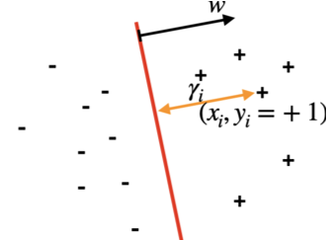
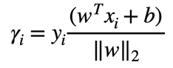
SVM: Geometric Margin
Given a set of training examples {(x_{i}, y_{i})}^{n}_{i=1}
A linear classifier will be (𝑤∗)^{𝑇}𝑥 = 0
We define functional margin of w with respect to a training example (x_{i}, y_{i}) as the distance from the point (x_{i}, y_{i}) to the decision boundary, which is

Slide 24
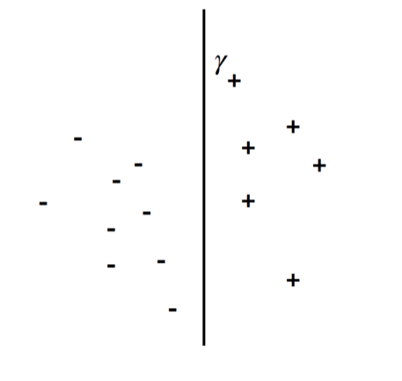
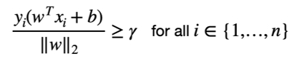
Maximum Margin Classifier
We propose the following optimization problem, maximize the margin.
This is hard to do:
maximize the numerator
minimize the denominator
How about we just try to do this if we assume γ is a lower bound on the margin?

Slide 25
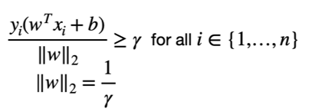
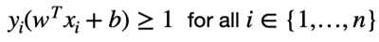
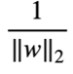
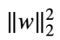
Maximum Margin Classifier
Still hard to optimize, so we reparameterization if we condition the numerator is >=1:
Conditioning on
So we can see we want to maximize , which is minimize
This is is a quadratic problem with linear constraints, easy to solve

Slide 26
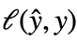
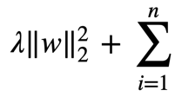
Don’t Forget It’s Still a Classifier
We want to have a loss function that conditioning on the
So the overall SVM algorithm is try to optimize:

Slide 27
Perceptron

Slide 28
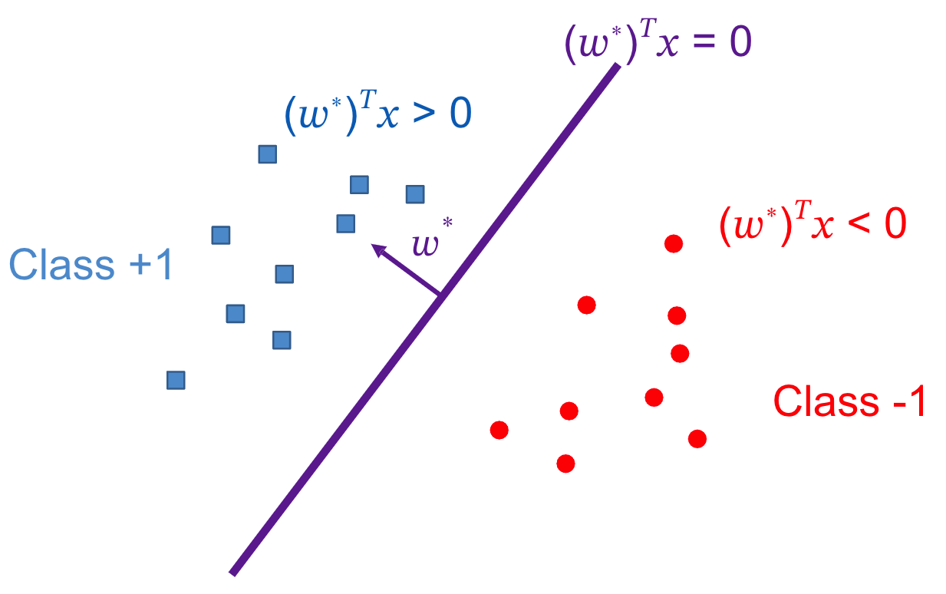
Perceptron
One of the most primitive form of learning and it is used to classify linearly-separable datasets.
Given two data points, Perceptron tries to find a hyperplane that separates the data. There can be numerous hyperplane that separates two data points in Perceptron.
Similar to SVM but simpler.
https://www.ling.upenn.edu/courses/cogs501/Rosenblatt1958.pdf

Slide 29
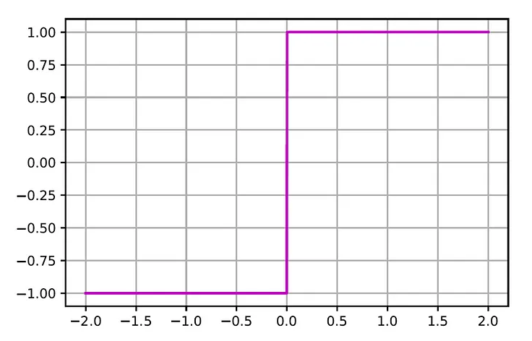
Attempt
Given training data {(𝑥_{𝑖} , 𝑦_{𝑖} ): 1 ≤ 𝑖 ≤ 𝑛} i.i.d. from distribution 𝐷
Hypothesis 𝑓_{w}(𝑥) = 𝑤^{𝑇}𝑥
𝑦 = +1 if 𝑤^{𝑇}𝑥 > 0
𝑦 = −1 if 𝑤^{𝑇}𝑥 < 0
Prediction: 𝑦 = sign(𝑓_{w}(𝑥)) = sign(𝑤^{𝑇}𝑥)
Goal: minimize classification error
The sign function is a function whose value is -1 for negative inputs and 1 for non-negative inputs

Slide 30
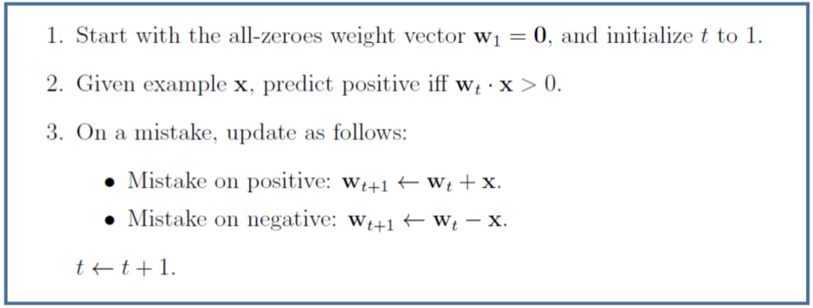
Perceptron Algorithm
Assume for simplicity: all 𝑥_{𝑖} has length 1
Perceptron: figure from the lecture note of Nina Balcan

Slide 31
Perceptron vs. SVM
Perceptron learning algorithm works better with linear data, but not better than SVM algorithm.
There can be different hyperplane that a Perceptron can generate in different experiments. And it solely depends upon the initial weights.
SVM keeps a classification margin on each side so that it classifies test data points that come near to the boundary properly.
The margin of the SVM makes SVM more robust in getting more closer to the real boundary (target function) of the datasets
https://colab.research.google.com/drive/1rB1xsYvWZ4Z-peFHJE1zahK9LTCSvwx9#scrollTo=cwVmdSQMfEUO&line=1&uniqifier=1

Slide 32
Neural Network

Slide 33
Neural Network
Origins: Neural Network was trying to mimic the brain.
Was widely used in 80s and early 90s; popularity diminished in late 90s.
Recent resurgence: State-of-the-art technique for many applications
A single-layer perceptron is the basic unit of a neural network.

Slide 34

Biological Neural Networks
A biological neural network (such as the one we have in our brain) is composed of a large number of nerve cells called neurons.
Each neuron receives electrical signals (impulses) from its neighboring neurons via fibers called dendrites. When the total sum of its incoming signals exceeds some threshold, the neuron “fires” its own signal via long fibers called axons that are connected to the dendrites of other neurons.
The junction between two neurons is called a synapse. On average, each neuron is connected to about 7,000 synapses, which demonstrates the high connectivity of the network we have in our brain. When we learn new associations between two concepts, the synaptic strength between the neurons that represent these concepts is strengthened. This phenomenon is known as Hebb’s rule (1949) that states “Cells that fire together wire together”.

Slide 35
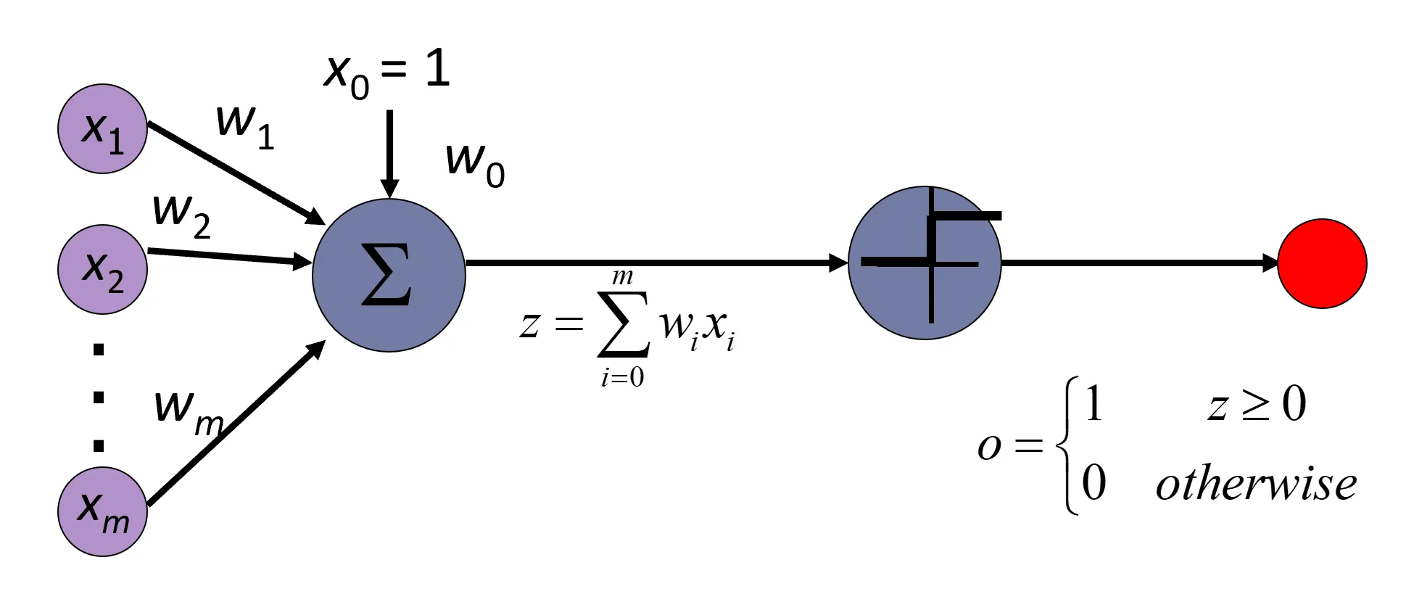
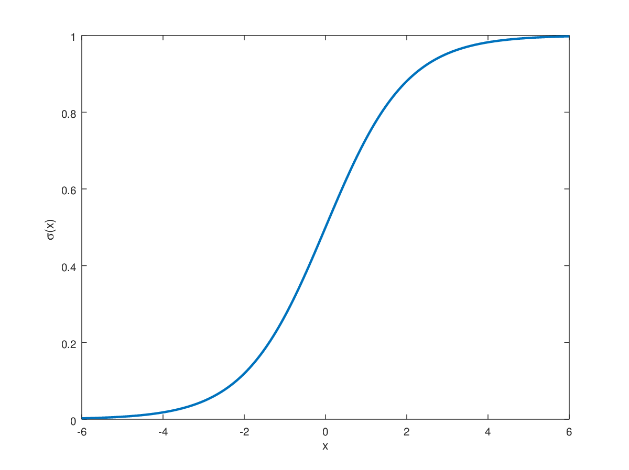
Perceptron Model
Each input neuron xᵢ is connected to the perceptron via a link whose strength is represented by a weight wᵢ. Inputs with higher weights have a larger influence on the perceptron’s output.
More generally, the perceptron applies an activation function f(z) on the net input that generates its output.
Input
Output
The sign function is a function whose value is -1 for negative inputs and 1 for non-negative inputs. We can also use sigmoid function.

Slide 36
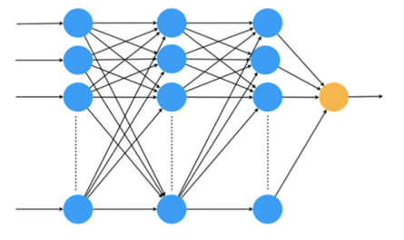
Neural Model: Stack Neurons Together by Layers
x₁
x₂
x₃
…
x_{n}

Slide 37
Neural Model: Stack Neurons Together by Layers
x₁
y₁
x₂
y
x₃
y₃
…
…
x_{n}
y_{n}
Inputs
Outputs

Slide 38
Neural Model: Stack Neurons Together by Layers
x₁
y₁
x₂
y
x₃
y₃
…
…
x_{n}
y_{n}
Inputs
Outputs

Slide 39
Neural Model: Stack Neurons Together by Layers
x₁
x₂
x₃
…
x_{n}
Inputs
Outputs

Slide 40
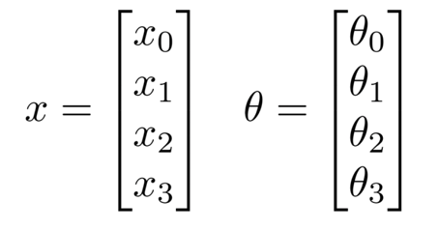
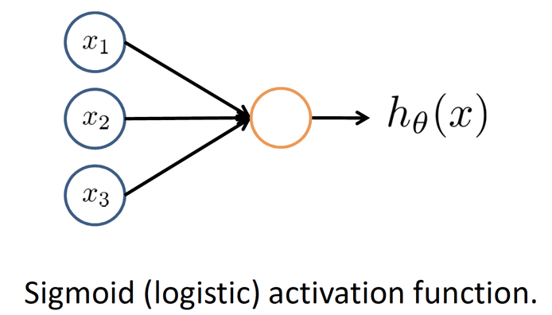
Neuron Model:

Slide 41
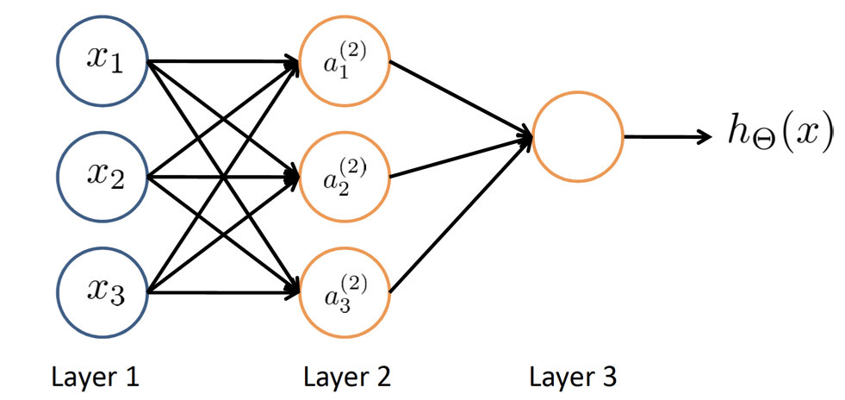
Neural Network

Slide 42
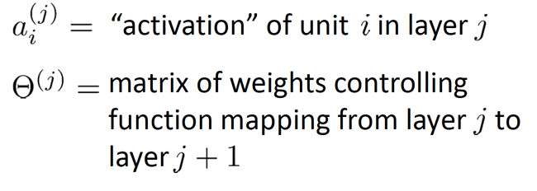
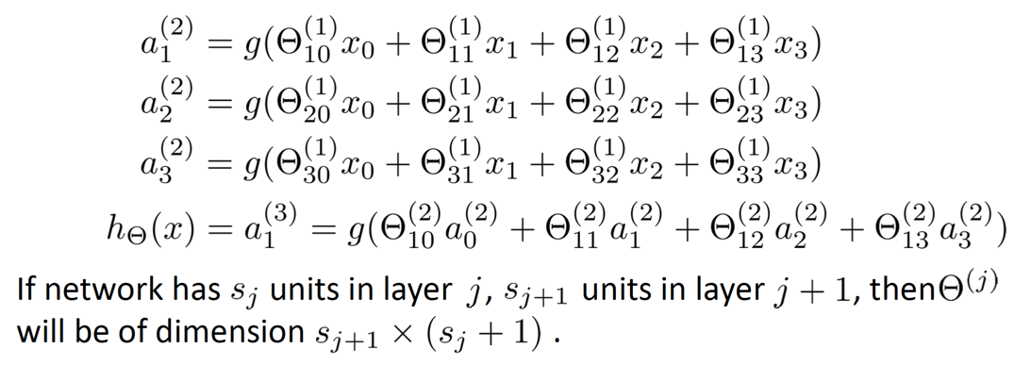
Neural Network

